Slide 1
Basic Elements of a
Data Warehouse
Prof. Navneet Goyal
Department Of Computer Science
BITS, Pilani

Slide 2
Basic Elements of a DW
Source Systems
Data Staging Area
Presentation Servers
Data Mart/Super Marts
Data Warehouse
Operational Data Store
OLAP
Kimball vs. Inmon
© Prof. Navneet Goyal, Dept. of Comp. Sc.

Slide 3
Data Warehousing Architecture
Monitoring & Administration
OLAP servers
Metadata Repository
Analysis
Query/ Reporting
Data Mining
Data
Warehouse
External Sources
Extract
Transform
Load
Refresh
Serve
Operational dbs
© Prof. Navneet Goyal, Dept. of Comp. Sc.
Data Marts

Slide 4
Data Marts
What is a data mart?
Advantages and disadvantages of data marts
Issues with the development and management of data marts
© Prof. Navneet Goyal, Dept. of Comp. Sc.

Slide 5
Data Marts
A subset of a data warehouse that supports the requirements of a particular department or business process
Characteristics include:
  Does not always contain detailed data unlike data warehouses
  More easily understood and navigated
  Can be dependent or independent
© Prof. Navneet Goyal, Dept. of Comp. Sc.

Slide 6
Reasons for Creating Data Marts
Proof of Concept for the DW
Can be developed quickly and less resource intensive than DW
To give users access to data they need to analyze most often
To improve query response time due to reduction in the volume of data to be accessed
© Prof. Navneet Goyal, Dept. of Comp. Sc.

Slide 7
Kimball vs Inmon
Bill Inmon's paradigm: Data warehouse is one part of the overall business intelligence system. An enterprise has one data warehouse, and data marts source their information from the data warehouse. In the data warehouse, information is stored in 3rd normal form.
Ralph Kimball's paradigm: Data warehouse is the conglomerate of all data marts within the enterprise. Information is always stored in the dimensional model.
© Prof. Navneet Goyal, Dept. of Comp. Sc.

Slide 8
Kimball vs Inmon
Bill Inmon: Endorses a Top-Down design
Independent data marts cannot comprise an effective EDW. Organizations must focus on building EDW
Ralph Kimball: Endorses a Bottom-Up design
EDW effectively grows up around many of the several independent data marts – such as for sales, inventory, or marketing
© Prof. Navneet Goyal, Dept. of Comp. Sc.

Slide 9
Kimball vs Inmon: War of Words
"...The data warehouse is nothing more than the union of all the data marts...,"
Ralph Kimball, December 29, 1997.
"You can catch all the minnows in the ocean and stack them together and they still do not make a whale,"
Bill Inmon, January 8, 1998.
© Prof. Navneet Goyal, Dept. of Comp. Sc.

Slide 10
Data Warehouse or Data Mart First?
Top-Down vs. Bottom-Up Approach
Advantages of Top-Down
  A truly corporate effort, an enterprise view of data
  Inherently architected-not a union of disparate DMs
  Central rules and control
  May be developed fast using iterative approach
© Prof. Navneet Goyal, Dept. of Comp. Sc.

Slide 11
Data Warehouse or Data Mart First?
Disadvantages of Top-Down
  Takes longer to build even with iterative method
  High exposure/risk to failure
  Needs high level of cross functional skills
  High outlay without proof of concept
  Difficult to sell this approach to senior management and sponsors
© Prof. Navneet Goyal, Dept. of Comp. Sc.

Slide 12
Data Warehouse or Data Mart First?
Advantages of Bottom-Up Approach
  Faster and easier implementation of manageable pieces
  Favorable ROI and proof of concept
  Less risk of failure
  Inherently incremental; can schedule important DMs first
  Allows project team to learn and grow
© Prof. Navneet Goyal, Dept. of Comp. Sc.

Slide 13
Data Warehouse or Data Mart First?
Disadvantages of Bottom-Up Approach
  Each DM has its own narrow view of data
  Permeates redundant data in every DM
  Difficult to integrate if the overall requirements are not considered in the beginning
Kimball’s approach is considered as a Bottom-Up approach, but he disagrees
© Prof. Navneet Goyal, Dept. of Comp. Sc.

Slide 14
The Bottom-Up Misnomer
Kimball encourages you to broaden your perspective both “vertically” and “horizontally” while gathering business requirements while developing data marts
© Prof. Navneet Goyal, Dept. of Comp. Sc.

Slide 15
The Bottom-Up Misnomer
Vertical
  Don’t just rely on the business data analyst to determine requirements
  Inputs from senior managers about their vision, objectives, and challenges are critical
  Ignoring this vertical span might cause failure in understanding the organization’s direction and likely future trends
© Prof. Navneet Goyal, Dept. of Comp. Sc.

Slide 16
The Bottom-Up Misnomer
Horizontal
  Look horizontally across the departments before designing the DW
  Critical in establishing the enterprise view
  Challenging to do if one particular department if funding the project
  Ignoring horizontal span will create isolated, department-centric databases that are inconsistent and can’t be integrated
  Complete coverage in a large organization is difficult
  One rep. from each dept. interacting with the core development team can be of immense help
© Prof. Navneet Goyal, Dept. of Comp. Sc.

Slide 17
Data Warehouse or Data Mart First?
New Practical approach by Kimball
  Plan and define requirements at the overall corporate level
  Create a surrounding architecture for a complete warehouse
  Conform and standardize the data content
  Implement the Data Warehouse as a series of Supermarts, one at a time
© Prof. Navneet Goyal, Dept. of Comp. Sc.

Slide 18
A Word about SUPERMARTS
Totally monolithic approach vs. totally stovepipe approach
A step-by-step approach for building an EDW from granular data
A Supermart s a data mart that has been carefully built with a disciplined architectural framework
A Supermart is naturally a complete subset of the DW
A Supermart is based on the most granular data that can possible be collected and stored
Conformed dimensions and standardized fact definitions
© Prof. Navneet Goyal, Dept. of Comp. Sc.

Slide 19
Pilot Projects: Risk vs. Reward
Start with a pilot implementation as the first rollout for DW
Pilot projects have advantage of being small and manageable
Provide organization with a “proof of concept”
© Prof. Navneet Goyal, Dept. of Comp. Sc.

Slide 20
Pilot Projects: Risk vs. Reward
Functional scope of a pilot project should be determined based on:
The Degree of risk enterprise is willing to take
The potential for leveraging the pilot project
    Avoid constructing a throwaway prototype
    Pilot warehouse must have actual value to the enterprise
© Prof. Navneet Goyal, Dept. of Comp. Sc.

Slide 21
Pilot Projects: Risk vs. Reward
High Risk Low Reward | High Risk High reward
Low Risk Low Reward | Low Risk High Reward
RISK
REWARD
© Prof. Navneet Goyal, Dept. of Comp. Sc.

Slide 22
Kimball vs. Inmon
There is no right or wrong between these two ideas, as they represent different data warehousing philosophies. In reality, the data warehouse in most enterprises are closer to Ralph Kimball's idea. This is because most data warehouses started out as a departmental effort, and hence they originated as a data mart. Only when more data marts are built later do they evolve into a data warehouse.
© Prof. Navneet Goyal, Dept. of Comp. Sc.

Slide 23
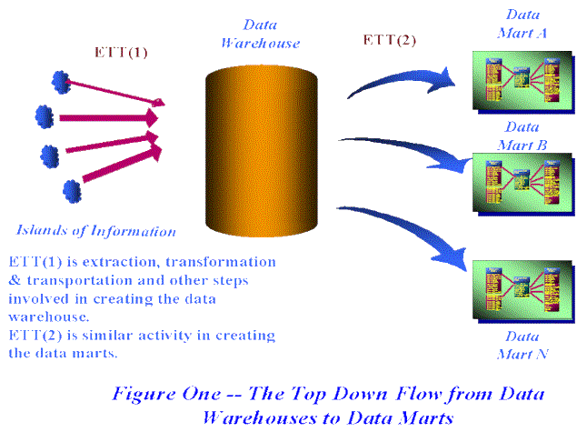
Dependent Data Marts
© Prof. Navneet Goyal, Dept. of Comp. Sc.
Figure source unknown

Slide 24
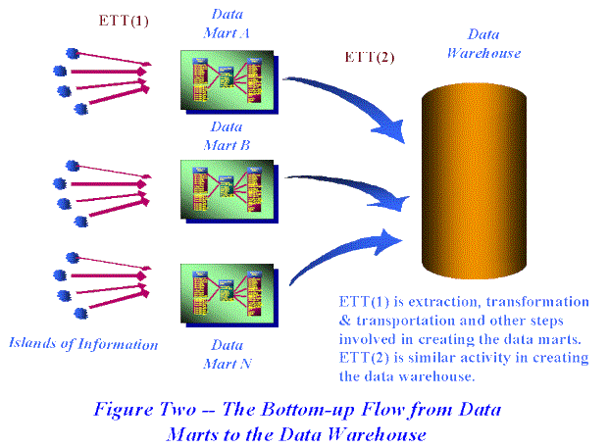
Independent Data Marts
© Prof. Navneet Goyal, Dept. of Comp. Sc.
Figure source unknown

Slide 25
References
The Bottom-Up misnomer, Margy Ross and Ralph Kimball,
http://www.intelligententerprise.com/030917/615warehouse1_1.shtml,
September 2003.
Data Warehousing Fundamentals, Paulraj Pooniah, J Wiley, 2012.
The Data Warehouse Toolkit, 3e, Ralph Kimball, J Wiley, 2002.
Data Warehousing: Architecture and Implementation, Mark Humphries et al., Pretince Hall PTR, 1999.
Building the Data Warehouse, 4e, WH Inmon,
© Prof. Navneet Goyal, Dept. of Comp. Sc.

Slide 26
ODS
An operational data store (ODS) is a type of database often used as an interim area for a data warehouse.
ODS Is highly volatile
An ODS is designed to quickly perform relatively simple queries on small amounts of data (such as finding the status of a customer order)
An ODS is similar to your short term memory in that it stores only very recent information; in comparison, the data warehouse is more like long term memory in that it stores relatively permanent information.

Slide 27
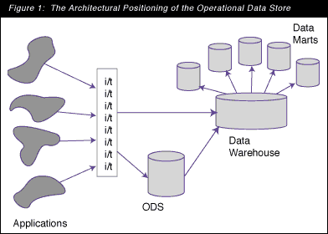
ODS
Figure taken from The Operational Data Store:
Designing the Operational Data Store, By Bill Inmon, DM Review, July 1998

Slide 28
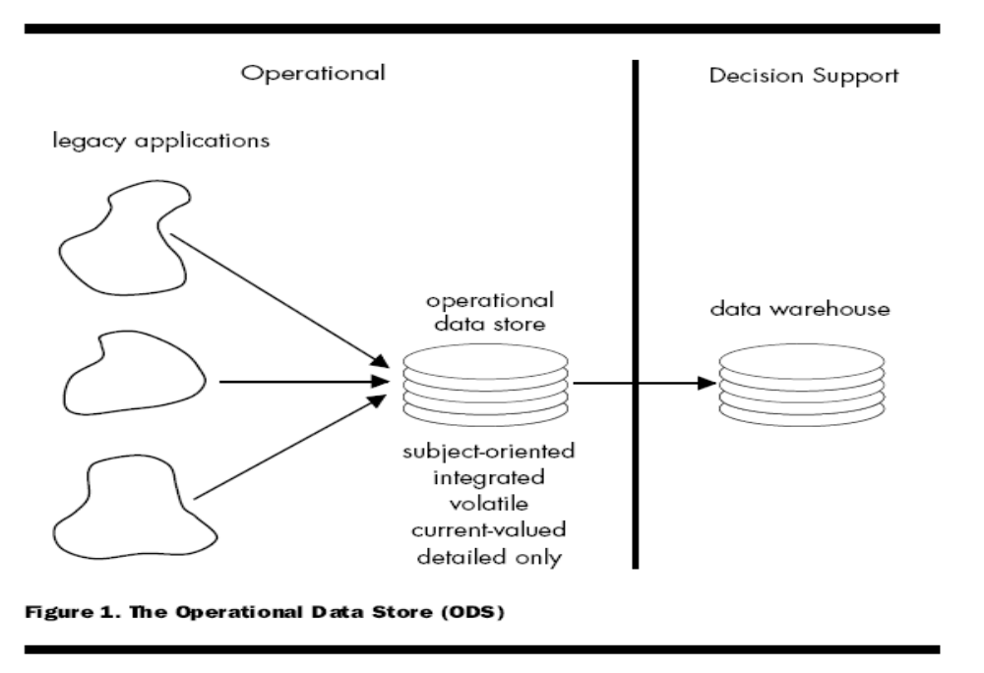
ODS
Figure taken from The Operational Data Store:
By Bill Inmon, INFO DB, 1995

Slide 29
ODS
In Figure 1 the ODS is seen to be an architectural structure that is fed by integration and transformation (i/t) programs. These i/t programs can be the same programs as the ones that feed the data warehouse or they can be separate programs.
The ODS, in turn, feeds data to the data warehouse.

Slide 30
ODS
According to Inmon, an ODS is a "subject-oriented, integrated, volatile, current valued data store, designed to serve operational users as they do high performance integrated processing.
In the early 1990s, the original ODS systems were developed as a reporting tool for administrative purposes

Slide 31
ODS
Subject-oriented
    Customer, product, account, vendor etc.
Integrated
    Data is cleansed, standardized and placed into a consistent data model
Volatile
    UPDATEs occur regularly, whereas data warehouses are refreshed via INSERTs to firmly preserve history
Current valued
    Changes are made almost with zero latency

Slide 32
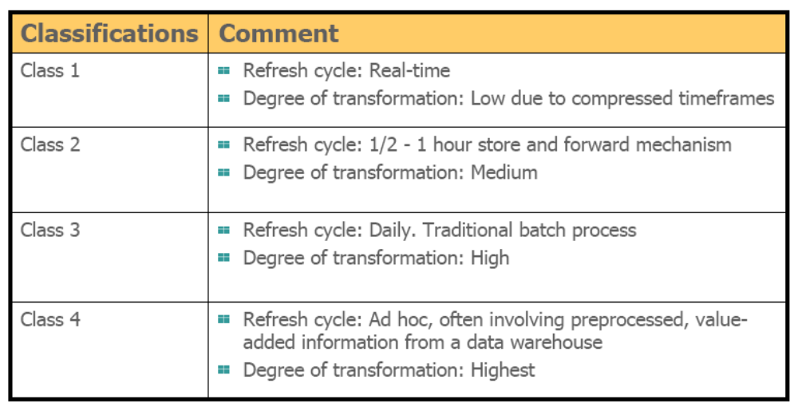
Classification of ODS
Table source unknown

Slide 33
ODS
ODS is also referred to as Generation 1 DW
Separate system that sits between source transactional system & DW
Hot extract used for answering narrow range of urgent operational questions like:
  Was the order shipped?
  Was the payment made?
ODS is particularly useful when:
  ETL process of the main DW delayed the availability of data
  Only aggregated data is available

Slide 34
ODS
ODS plays a dual role:
  Serve as a source of data for DW
  Querying
Supports lower-latency reporting through creation of a distinct architectural construct & application separate from DW
Half operational & half DSS
A place where data was integrated & fed to a downstream DW
Extension of the DW ETL layer

Slide 35
ODS
ODS has been absorbed by the DW
  Modern DWs now routinely extract data on a daily basis
  Real-time techniques allow the DW to always be completely current
  DWs hav become far more operational than in the past
  Footprints of conventional DW & ODS now overlap so completely that it is not fruitful to make a distinction between the kinds of systems

Slide 36
ODS
Classification of ODS based on:
  Urgency
    Class I - IV
  Position in overall architecture
    Internal or External

Slide 37
A Word About ODS
Urgency
  Class I – Updates of data from operational systems to ODS are synchronous
  Class II – Updates between operational environment & ODS occurs between 2-3 hour frame
  Class III – synchronization of updates occurs overnight

Slide 38
A Word About ODS
Urgency
  Class IV – Updates into the ODS from the DW are unscheduled
    Data in the DW is analyzed, and periodically placed in the ODS
    For Example –Customer Profile Data
    Customer Name & ID
    Customer Volume – High/low
    Customer Profitability – High/low
    Customer Freq. of activity – very freq./very infreq.
    Customer likes & dislikes

Slide 39
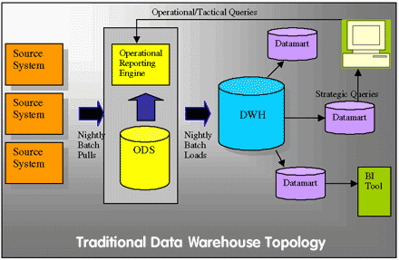
ODS

Slide 40
ODS & Real-Time Data Warehousing
Which class of ODS can be used for RTDWH?
HOW?
Let us first look at what we mean by RTDWH
Wait till we talk about RTDWH

Slide 41
Q & A

Slide 42
Thank You

